Slide 1
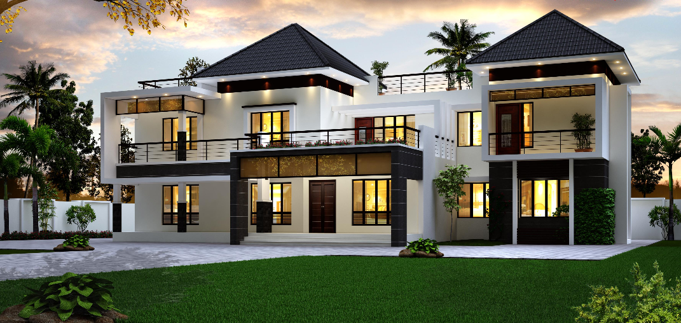

ACTV
Your Trusted Property Agency
Ariffin
Christopher
Terence
Vee Vian
https://GoogleSlidesThemes.com

Slide 2

CLIENT BACKGROUND
JASON PITTMAN
01
02
Profile
Past Transaction
35 years old
Single, Getting married
Plan to have 3 kids
Annual income, USD90k
bought a house at HKRidge
in year 2014
Agent: Herman Sherlock
02

Slide 3
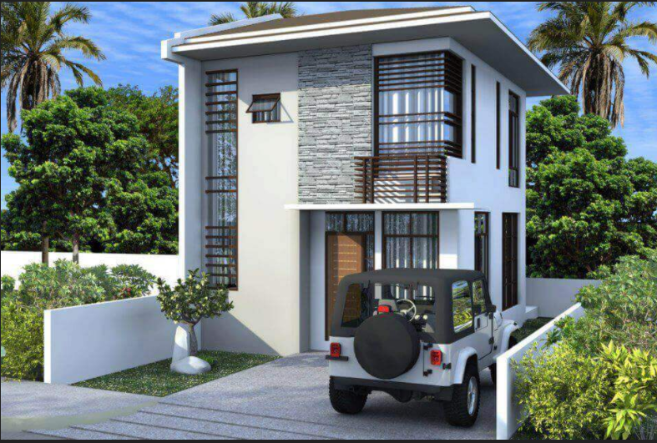
THE HOUSE
Ames, IA
2222, Hamilton Dr.
NorthRidge Height
01
Bought at USD 200k
Present value at USD 277k
02
2,115 square feet
0.18 acres
3 bedrooms
4 total baths
House : Average -- Good
Garage : Average
Basement : Average
03
03

Slide 4

Situation
Want to optimize the selling price of his house so that he can have more fund to start off a new chapter in his life - marriage
Complication
Have a limited renovation budget and do not have the domain knowledge.
04
Notes:
Base on our model , there are many features that have strong correlation with respect to the Sale Price. However in the standpoint of a seller in our business study , many of these numeric feature are already cast in stone and not wise to varies. Instead , we will study into features that could be physically implemented and improved upon such as House QC and cond , Garage QC and cond , Kitchen QC, etc.

Slide 5

PROBLEM STATEMENT
By tapping into our domain & machine learning expertise,
How might we apply our “State-of-the-Art” model while taking renovation budget into account
So that we can help to maximize Home ROI
05
Notes:
Base on our model , there are many features that have strong correlation with respect to the Sale Price. However in the standpoint of a seller in our business study , many of these numeric feature are already cast in stone and not wise to varies. Instead , we will study into features that could be physically implemented and improved upon such as House QC and cond , Garage QC and cond , Kitchen QC, etc.
With the current in-house predicting model that we have, how can we help him to optimize the sale price of the house with the limited renovation budget that he has.
so that he can have a better return from the renovation spending.
How can we increase the saleprice based on

Slide 6
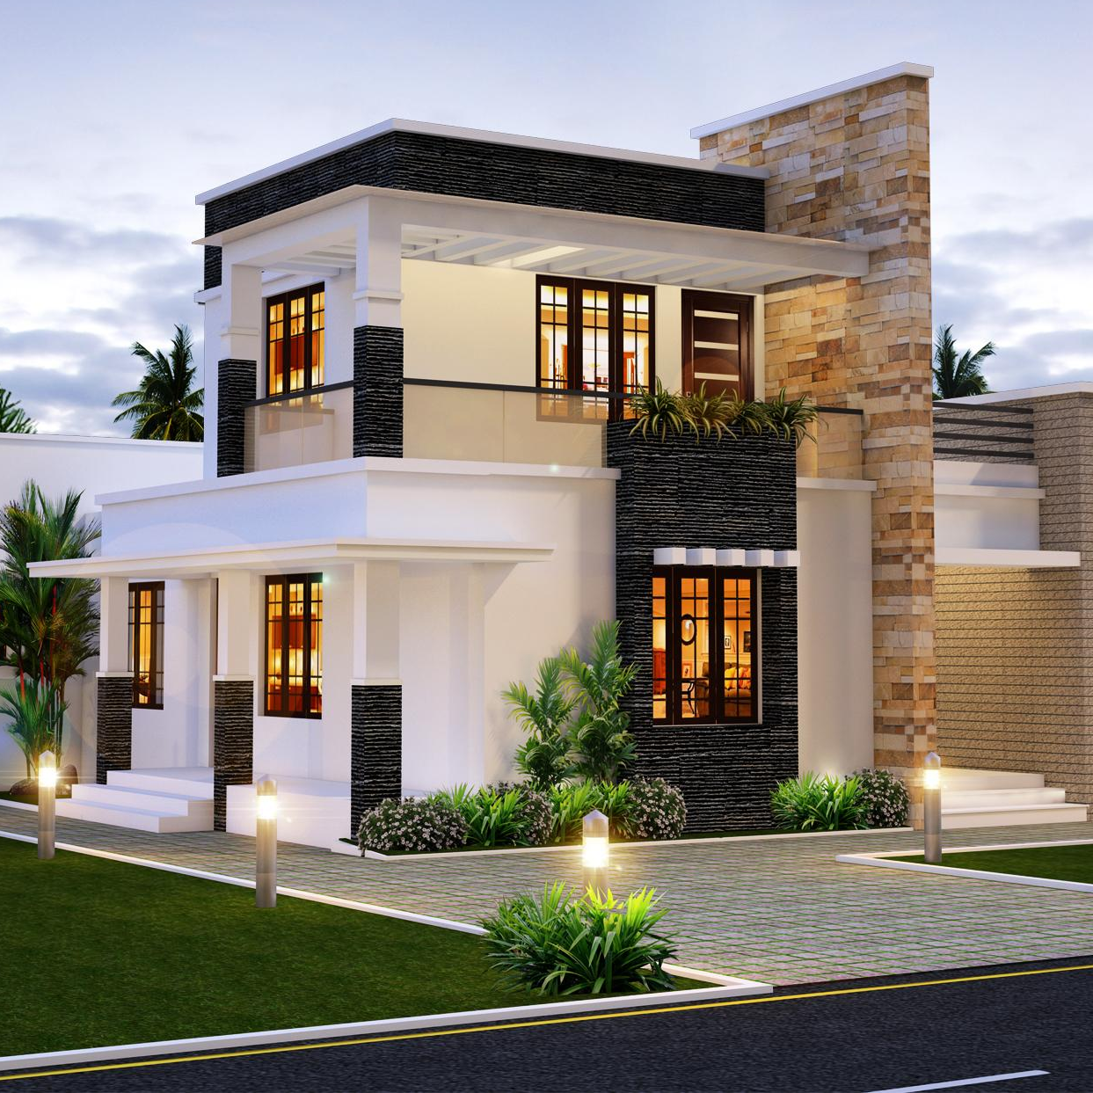
OUR MISSION
Identify the potential house features to improve.
Increase the potential selling value by looking into our research & model analysis.
Aim to maximise his returns from renovating the house with the set aside budget, ~USD20k
06
Notes:
Ridge Model for info.

Slide 7

OVERVIEW OF AMES CITY
CITY
Population: 66,023
Area size: 71.69 km²
Median House Value: $205,900
Top Employer: Iowa State University (16,811)
07
Notes:
Good neighbourhood

Slide 8
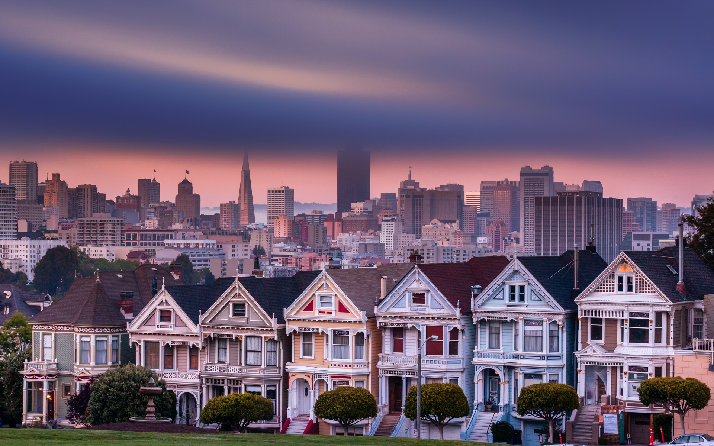
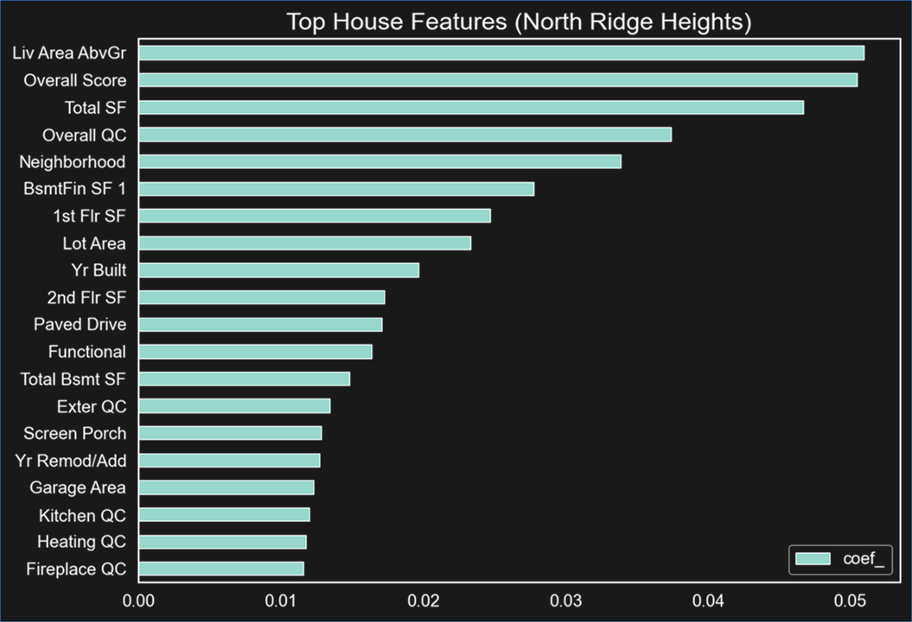
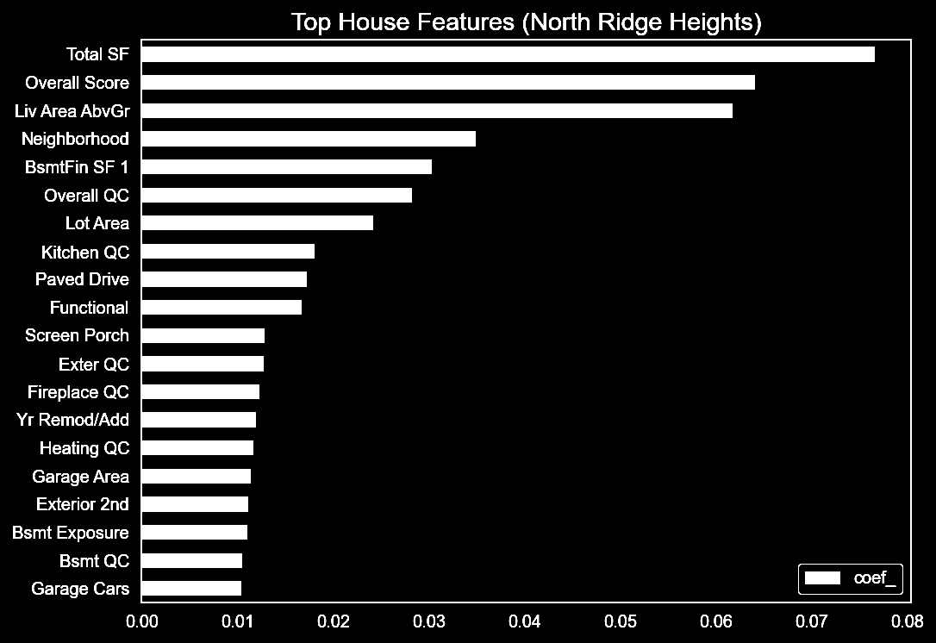
RELEVANT FEATURES
08
Notes:
by looking at neighbourhood features,we aren’t focusing on that because you can’t really relocate his house to the best neighbourhood right?
we focus on these features because they are the most cost savings in terms of renovation but have a big impact on the sale price!
Default house condition for kitchen and heating is already excellent :(
Base on our model , there are many features that have strong correlation with respect to the Sale Price. However in the standpoint of a seller in our business study , many of these numeric feature are already cast in stone and not wise to varies. Instead , we will study into features that could be physically implemented and improved upon such as House QC and cond , Garage QC and cond , BSMT QC, etc.

Slide 9
3 RECOMMENDATIONS
Many Features could be improved , but based on our ground assessment….
01
Overall House Condition
02
Garage
03
Basement
09
Notes:
Base on our model , there are many features that have strong correlation with respect to the Sale Price. However in the standpoint of a seller in our business study , many of these numeric feature are already cast in stone and not wise to varies. Instead , we will study into features that could be physically implemented and improved upon such as House QC and cond , Garage QC and cond , Kitchen QC, etc.

Slide 10
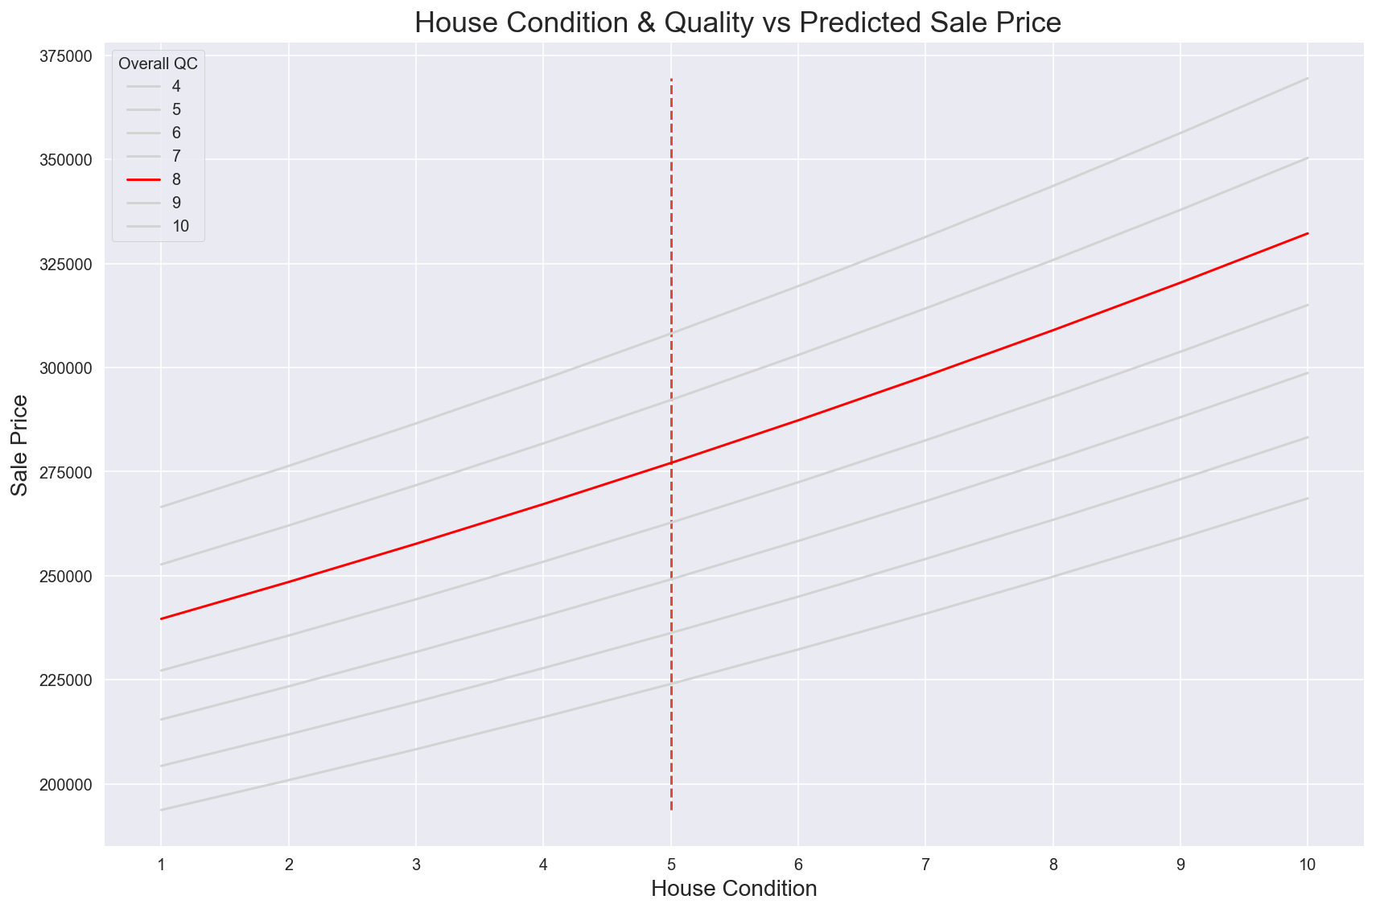


01 OVERALL HOUSE CONDITION
Renovation Package B
B
A
C
Renovation Package A
$277k
$298k (A)
$310k (B)
10
Notes:
Base on our assessment , Jason’s current house Condition is below average and there is much room to improve
Base on package A , we could help Jason to upsell his house from 277K to 298 K , an increase of $21,000 .. This will probably required simple modification on his house such as recoating your house with waterproof paints , changing his lighting lighting and some of the furnitures.
We also offered Jason an alternative package to consider if he had more budget. This package B includes doing up an IOT system to his house. As you all are aware , one of the more popular in-house feature that buyer look at is home IOT system. Just by adding this features on top on the base improvement, we are confident to help you to upsell your house from 277k to 310k , an increase of $33,000K as shown in the chart.
Next , we will look at Jason’s Garage

Slide 11
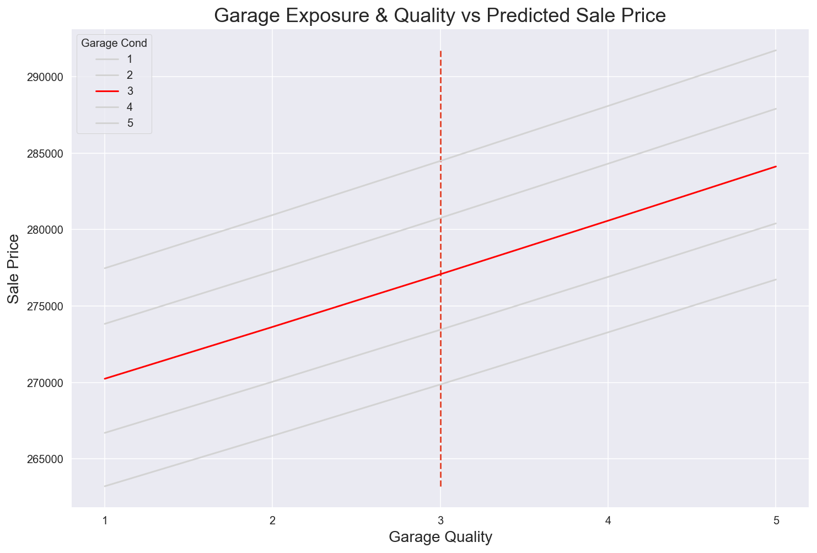


02 GARAGE
Renovation Package B
B
A
C
Renovation Package A
$277k
$281k(A)
$285k(B)
11
Notes:
Base on our assessment , Jason’s current Garage Condition is average.
Base on package A , we could help Jason to upsell his house from 277K to 281K , an increase of $4,000 .. This will probably required simple modification on his house such as adding drainage , waterproofing your floor and levelling your ground.
Likewise , We proposed to Jason an alternative package to consider if he had more budget. This package B includes doing up automated shuttle door for his Garage. This feature could be tie in together within the same IOT features proposed for his house and is currently one of the most in thing for the garage in the market now. This additional automated shuttle door will is expected to increase Jason house from 277k to 285k , an increase of $8,000K as shown in the chart.
The next feature we will look at is Jason’s Basement

Slide 12
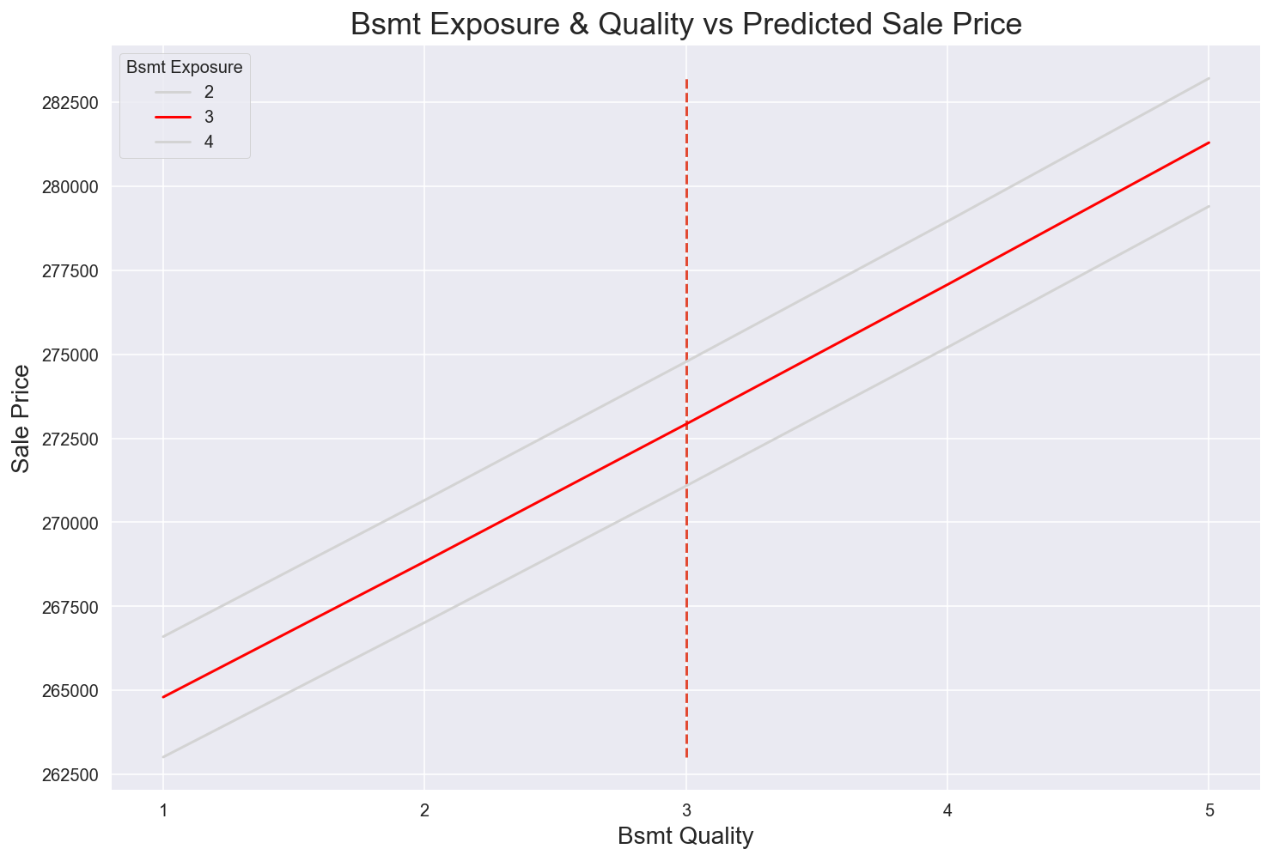
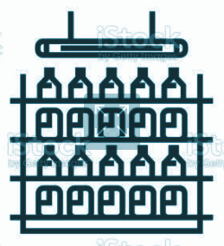

03 BASEMENT CONDITION
A
C
$277k
$281k
12
Notes:
Base on our assessment , Jason’s current Basement quality is already good and required minimal improvement
As Jason’s had a wine cellar for his basement , we recommended Jason to put up a simple remote monitoring control to regulate his aircon , as well as his lightings. This minimal feature improvement to his basement is set to increase Jason’s house by $4,000.
Moving on to the summary for both packages

Slide 13
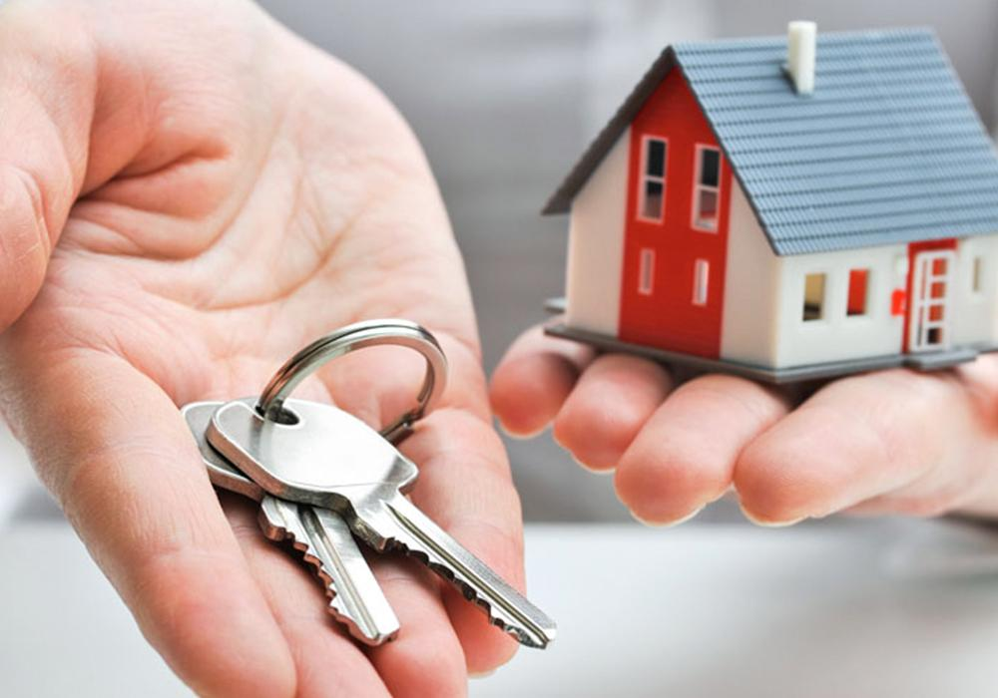
THE SOLUTION
 | Current Condition | Package A | Package B
Estimated Budget |  | ~15K USD | ~40K USD
House Condition | 5 | 7 | 8
Garage | 3 | 4 | 5
Basement | 4 | 5 | 5
Predicted Sale Price | $277,000 | $306,000 | $340,000
Net ROI |  | 4.6% | 8.3%
Jason Final’s Decision?
Package B with 8.3% Net ROI!
13
Notes:
By improving the features for your Garage , Basement and House Condition, our base package A will not only fulfill Jason initial requirement on renovation budget below 20K , but also help Jason to net an ROI of ~4.6% after the renovation expenses.
Our package B involved additional improvement towards towards IOT and automation features which will appeal to our current trendy buyers who are into the IOT home system.
We had worked very closely with Jason for the past 3 weeks and he had just recently made his decision. So anyone on the floor like to guess? As Jason had worked with us previously in his first house purchase , he is absolutely confident on our model quality as well as deliverables. He decided to commit more and work through together with us on Package B.!
Jason is smart.
Be like Jason.

Slide 14
NEXT STEP
We understand your financial pain point!
Subscribe to our Interior Design & Model Service
Minimize Renovation Cost , Maximise Sale Price
Optimising your Net ROI
14
Notes:
We had worked with many clients like Jason and their reviews on our house prediction model and services had been great so far. We understand your financial pain point and we are able to customise our model to your needs!
While we are able to predict qualitatively , we should also take into account that to improve a house feature, renovation budget will be required. Whether that outweighs the increase of Sale Price could be further studies together with our interior design team if you choose us as your first choice partner.
Our dedicated in house interior design team will help you minimize renovation expense , maximize your sales price and optimize your net ROI.

Slide 15

GET IN TOUCH
+1 234-567-8910
+1 234-567-8911
123 Main Street, GA Building, Iowa City, USA. 12345
ACTVmail@email.com
ACTVmail1@email.com
15
Notes:
We hope to hear from you soon!

Slide 16


THANK YOU

Slide 17
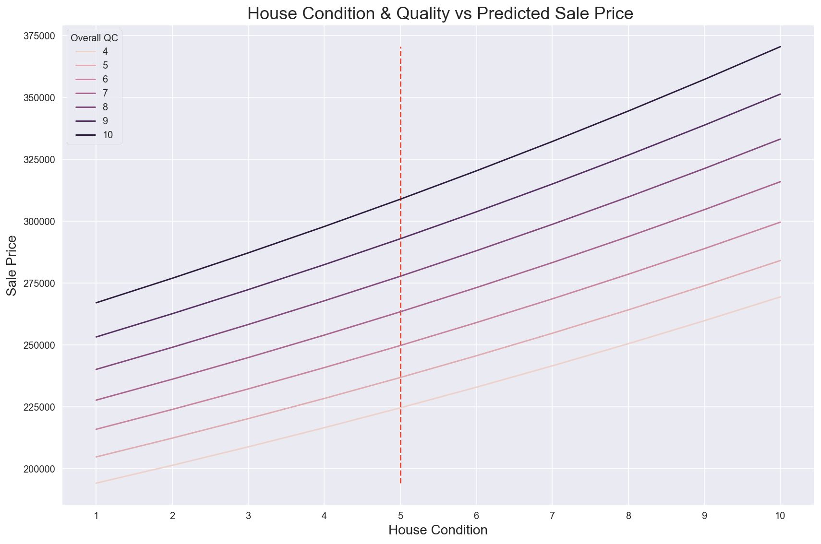
APPENDIX
15

Slide 18
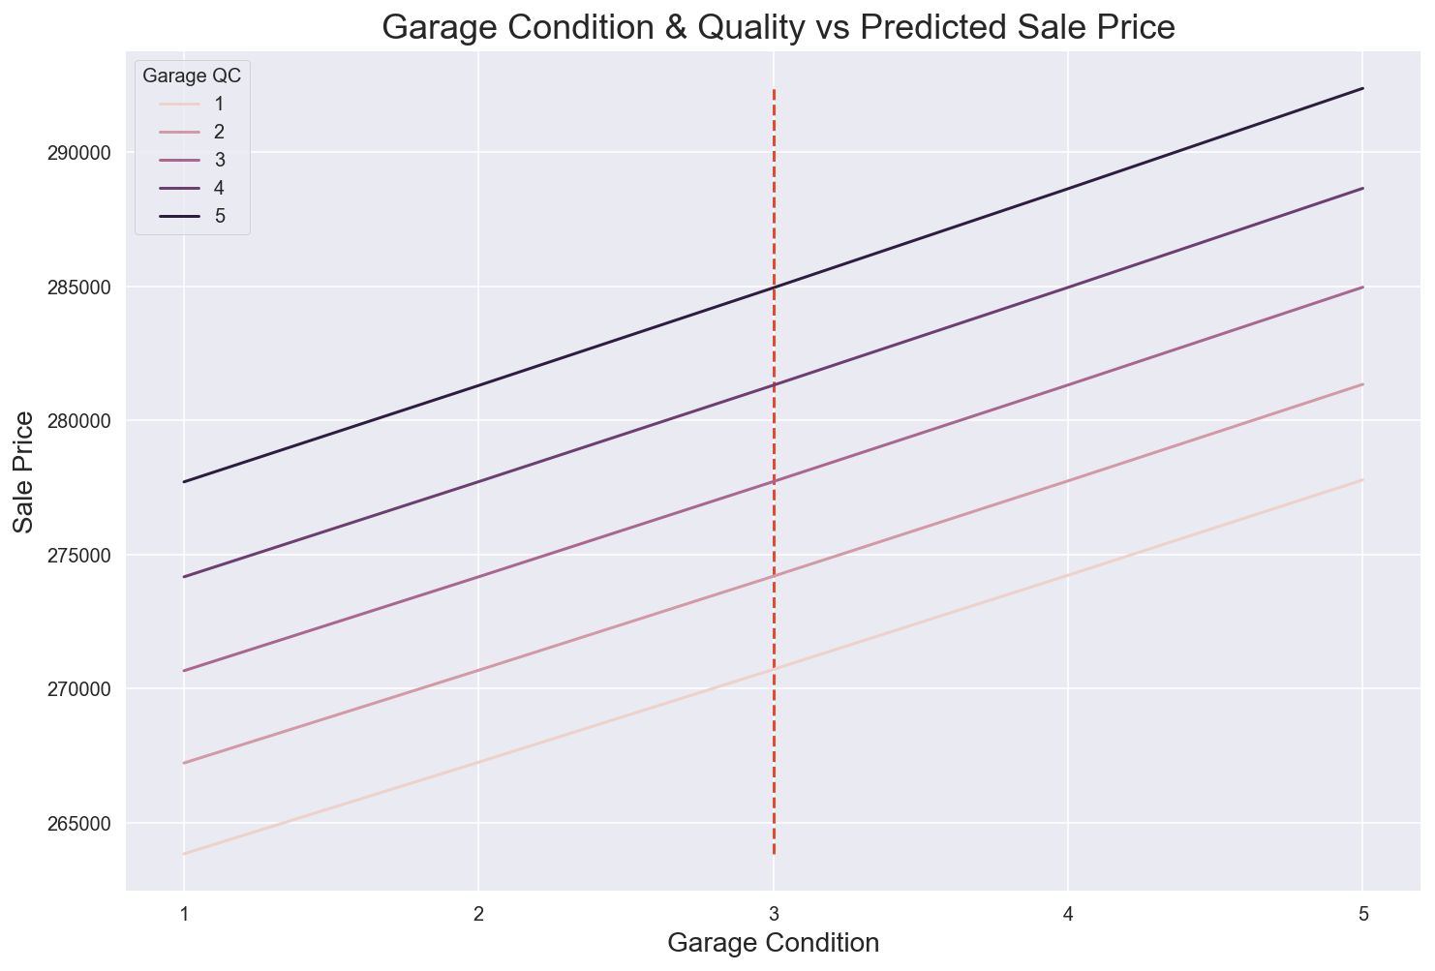
APPENDIX
15

Slide 19
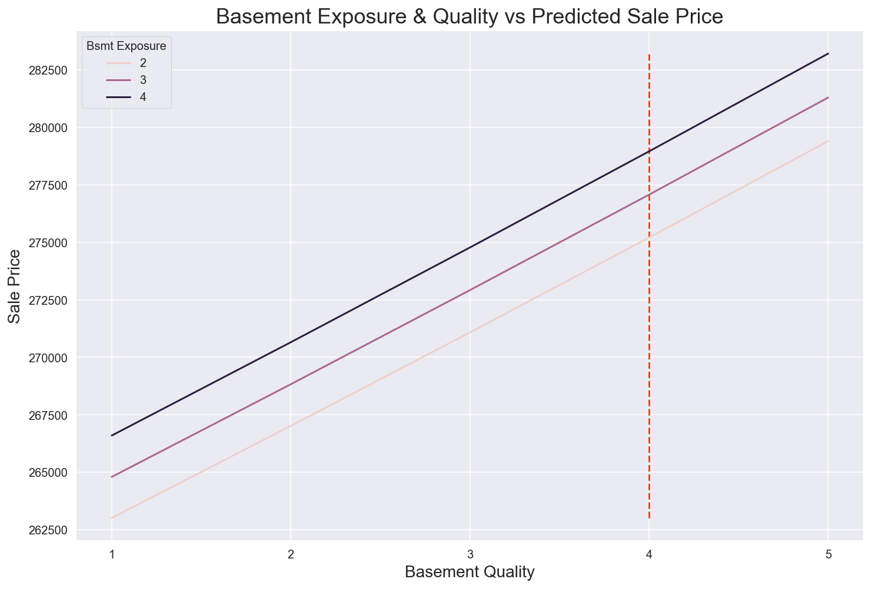
APPENDIX
15

